Slide 1
European Imperialism

Slide 2
Empire of the Turks
What began as a Arab-dominated empire, Islam experienced a shift in power to the Turks after the twelfth century
Up until World War I, the fanatical enmity between the Shi’ites of Safavid Iran and the Sunni Ottomans was the overriding source of conflict
both tried to curry favor of various European powers against the other
Europeans consequently benefited from special privileges proffered

Slide 3
18th Century Ottoman Empire
Ottoman Empire maintained a choke hold on the Black Sea by controlling the Bosporus
neither Russia nor Ottomans were stronger
in 1770’s the Russians and Ottomans came to blows over who would control the Black Sea
after 4 years the war ended in a draw as both sides were pressured to bring a conclusion
result: Treaty of Kuchuk Kainarji
Crimea became autonomous
Russia annexed Kerch and territories between Bug and Dnieper rivers, received right of free navigation on the Black Sea
Ottomans retained control of Moldavia, Wallachia

Slide 4
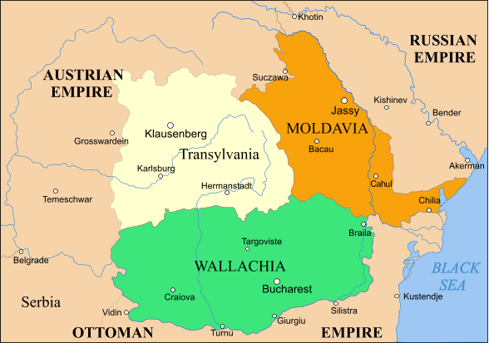

Slide 5
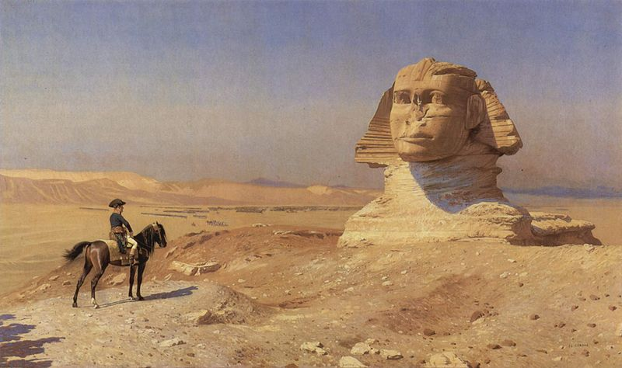
European Imperialism in Middle East

Slide 6
Napoleon in Egypt
Napoleon’s expedition into Egypt in 1798 opened the eyes of Europe to resources in Middle East
This was perceived as threat to France’s arch rival, Britain’s trade route to India,
Since 1778 British had treaty with Mamluks securing Red Sea shipping and maintained expedition in Suez
British East India Company was center piece of British foreign policy for over two centuries
Napoleon proclaimed himself as “friend of Islam” and ally to the Ottoman Sultan
he posed as liberator of Egypt from tyranny of Mamluks

Slide 7
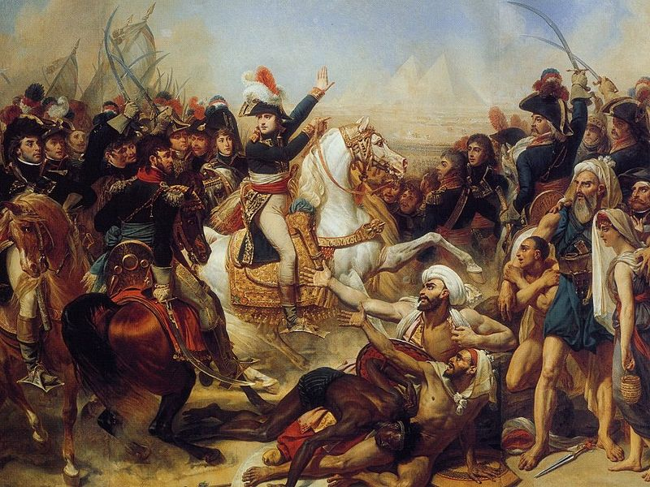

Slide 8
Napoleon Ousted
Napoleon’s army easily defeated Mamluk forces at Battle of Pyramids and Napoleon set up an administration in Cairo for a short time
a revolt broke out in Cairo against the French resulting in the death of chef de brigade Dupuy
Napoleon responded with brutal retaliation massacring hundreds of insurgents seeking refuge in the Great Mosque
Alarmed at French successes, the British offered to help rid the Ottoman Empire of the French intrusion
from Istanbul, the sultan sent Ottoman troops with fire support from the Royal Navy forced the French out of Egypt in 1801

Slide 9
Rise of Muhammad Ali
The invasion introduced Western inventions, such as the printing press, and ideas, such as liberalism and nationalism, to the Middle East,
influenced Egyptian independence & modernization under Muhammad Ali
appointed Pasha of Egypt in 1805, Muhammad Ali asked French experts to teach Egyptians the skills of modern naval and military warfare
the modern Egyptian military and navy accomplished many great things for the Ottoman sultan
In 1831, Muhammad Ali took Syria as “reward” for helping the Ottoman sultan

Slide 10
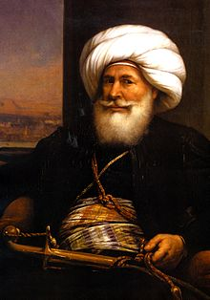
Opening Pandoras’ Box
KEY Statement: 18th and 19th Century British foreign policy would reflect an overriding concern to protect lines of trade with India.
Possessing most powerful forces in Middle East, Muhammad Ali went on to challenge the Ottoman sultan in 1833
panicked, the sultan sought the help of Russia, which the Tsar was all too happy to oblige
France, apprehensive that their protégé had bit off more than he could chew, asked Muhammad Ali to make peace with sultan
British viewed the situation with horror as both Russia and France had gained a foothold along their lifeline to India

Slide 11
Almost a Russian Lake
Russia saw their golden opportunity to secure the Black Sea:
signed Hunkyar Iskelesi Treaty with Ottomans
gave them right to send troops into Turkey whenever “conditions warranted”
Muhammad Ali complied with the French request and returned to Egypt/Syria
relieved crisis for 6 years
In 1839, the Ottoman Sultan died, Syria rose up
Ottoman navy and army stepped in to crush Syria’s rebellion but was defeated by Muhammad Ali’s forces;
the new sultan was willing to accede to Muhammad Ali’s demands

Slide 12
Defeat of Ottomans Averted
frantically suing for a diplomatic solution, Britain and France tried to persuade :
Russia, Prussia and Austria to agree to a treaty to secure navigational rights in exchange for non-belligerence
Muhammad Ali to settle for life-time control of Egypt and Syria
This time Muhammad Ali refused to be restrained from attempting to take the Ottoman Empire
While France hesitated, Britain stepped in, invading Syria with the help of the Druze people
the British took Beirut, defeated M. Ali’s forces in Syria

Slide 13
Straits Convention 1841
Muhammad Ali’s former mentor France failed to come to his aid, forcing him to abandon his plan
he acquiesced to accept role as hereditary pasha of Egypt and Syria
European powers signed Straits Convention in 1841
demilitarized straits by prohibiting movement of warships of any flag through them
British saw this as means of bottling up Russian Black Sea fleet and promoting the stability of region
Russians claimed treaty encouraged aggressive policies of Britain in the region, which would lead to the Crimean War
For remainder of 19th century, Britain and France would strive to keep the Ottoman Empire alive in order keep Russia out of the Mediterranean

Slide 14
Imperialism in Starts Egypt
Muhammad Ali’s penchant for modernization did much for Egypt’s agricultural economy:
agriculturally productive land rose 30%
the GNP increased 300% to ₤4,200,000
exports rose ten fold
prize crops were cotton and tobacco
Attempts to industrialize Egypt were defeated by the Anglo-Ottoman Commercial Treaty of 1838
enabled British to but directly from growers and circumvent Egyptian industries
After Muhammad Ali died in 1848, his successors sought to curry favor with the British in order to bolster their own power

Slide 15
Weakening of the Ottoman Empire
by the beginning of the 19th century the Janissary Corps had become so large, corrupt and indolent that they had to be disbanded
The weakened Ottoman empire began to lose its grip on Europe, they lost to Russia in 1828:
Greece and Serbia declared independent and mouth of Danube ceded to Russia in Treaty of Adrianople of 1829
Crimean War, Nicholas I of Russia thought to divide Ottoman Empire with Britain, instead found himself at war with the alliance of Britain, France and later Austria in defense of the Ottomans

Slide 16
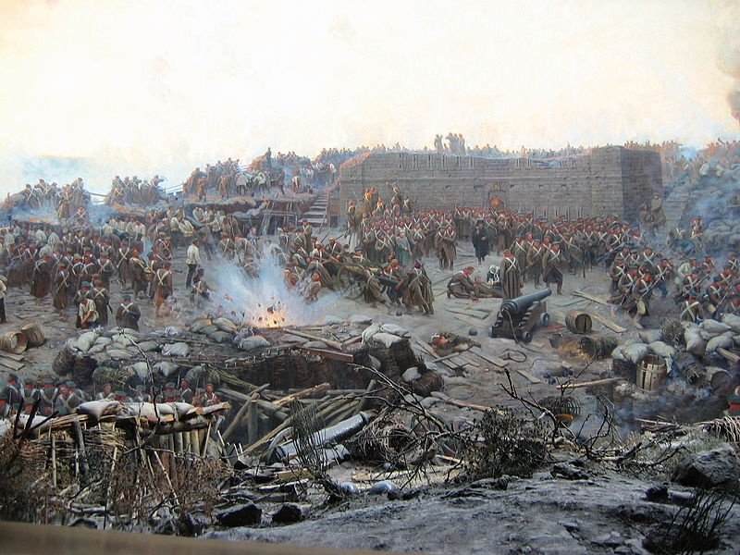
Crimean War 1853-1856

Slide 17
Crimean War
horrific losses suffered by both sides:
375,000 of Ottomans, British, French, Sardinian soldiers killed (more than half due to disease)
220,000 Russians killed (100,000 due to disease)
saw advent of improved surgical techniques and nursing
War ended with Treaty of Paris in March 1856
though part of victorious alliance, Ottomans lost autonomy (sold their soul to the allies)
anything which endangered the integrity of the Ottoman Empire was to “be considered a question of European interest”
Ottomans would be required to demonstrate some sort of “reform” from now until World War I

Slide 18
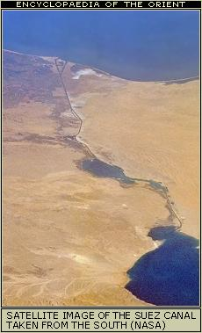
Suez Canal
No wonder that by 1869, British trade totaled 41% of Egypt’s imports and 49% of her exports
Ironically, when Frenchman Ferdinand de Lesseps proposed the completion of a large canal partially started by the ancient pharoahs, the British hotly opposed it.
some feared that although a canal would shorten the trip from London to Bombay, it would open access for Britain’s rivals to India

Slide 19
Suez Canal
de Lesseps raised the necessary capital in France, Holland, Italy and Spain
the charter of the Compagnie Universelle du Canal Maritime de Suez was awarded in 1856
gave concession of the canal to company for 99 years after completion
in exchange for 15% of net profit going to Egypt
begun in 1859, Egypt supplied 80% of labor force
canal was completed in 1869 at a cost of 11.5 million francs & the opening ceremony was a world class event

Slide 20
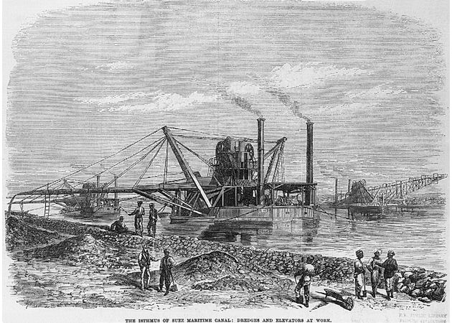

Slide 21
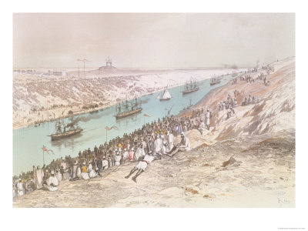
Inauguration of the Canal

Slide 22
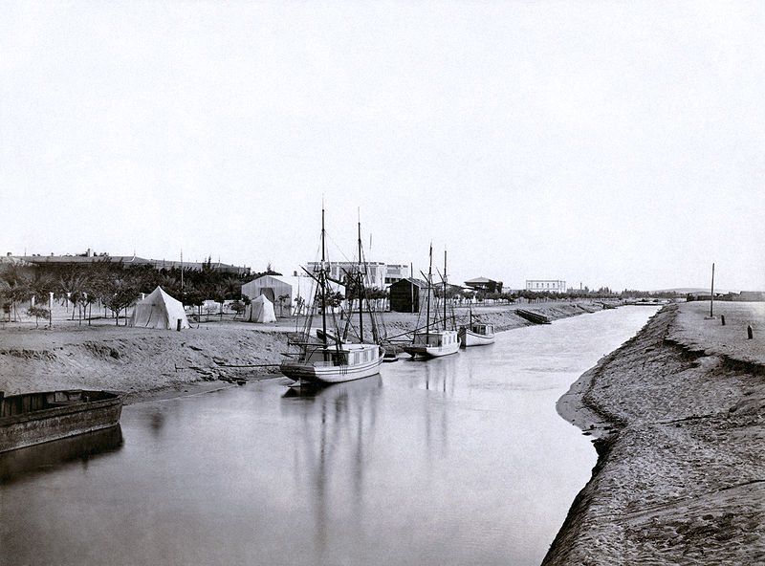
More than any other event, the Suez canal opened the Middle East to European imperialism. Now they had a vested interest in the canal and England, in particular, viewed the security the canal as vital to the safety of the trade link to India.

Slide 23
Constantinople Convention
In 1873 an international conference established a schedule of tariffs and decided the canal should be open to all nations
in 1888, Austria, France, Germany, Britain, Italy, Holland, Russia, Spain and Turkey signed the Constantinople Convention stating that the canal:
should “always be free and open in time of war as in time of peace, to every vessel of commerce or of war, without distinction of flag”

Slide 24
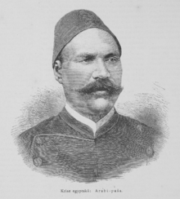
Egyptian Revolt
high taxes, incompetent government officials, presence of foreigners (including Turks), aroused animosity of young professional Egyptians
junior officers under the leadership of Col. ‘Urabi arose in protest in 1882.
because they were neither well organized or clear with ideas concerning a constitution, they were unsuccessful in toppling the government
riots broke out in Alexandria, killing Europeans and Egyptians
British used this as pretext for intervention

Slide 25
Egypt Becomes British Protectorate
on July 11, 1882, the British bombarded Alexandria.
Battle of Tel al-Kabir, British forces defeated the troops of Col. ‘Urabi, who was banished to Ceylon
British troops remained in Egypt until 1956 despite promises to withdraw “as soon as the state of the country and the organization of proper means for the maintenance of Khedival authority will permit it”
Although as British protectorate, Egypt was made financially solvent, there arose a spirit of Egyptian nationalism because of the foreign occupation

Slide 26
The Ottoman Empire Bankrupt
The Crimean War marked the first time Ottomans borrowed money from foreign banks
Once the door was opened, the sultans continued to borrow from European creditors
European lenders enjoyed such good profits they worked to make it convenient for sultans to borrow
by 1881, the whole empire went into receivership:
Council of Administration of Ottoman Public Debt, staffed by British, French, Dutch, German, Austrian and Italian creditors, took control of the empire’s economy
for first time, Ottoman citizens enjoyed some prosperity

Slide 27
Germans Make Inroads
Europeans found a goldmine of opportunities in the Middle East
the Germans under Kaiser Wilhelm II were not slack to take advantage of the Ottoman’s need for infrastructure:
built railroads from Berlin-to-Baghdad, modernized roads
supplied arms to the Ottomans
This alarmed the British, French and Russians & sought to neutralize German influence in region
while British and French were not in position to come to their aid, Russia once again went to war with the Ottomans in 1878 and wrested the remainder of Eastern Europe from the Ottomans
divided among Austria (Bosnia & Herzegovina), Russia (Bessarabia, Batum and Kars), Britain (Cyprus) and Greece; Serbia and Montenegro became independent

Slide 28
Last Vestiges of Pan-Islam
by the end of 19th century, nearly all of Islamic states were either directly occupied or had restricted sovereignty by European powers particularly Britain, France and Russia
Last Ottoman sultan with unrestrained authority was Abdul Hamid II (1876-1909), a cunning leader
promoted Pan-Islamic solidarity to strengthen leverage with European powers
expanded state educational system to counter spread of foreign-sponsored (esp Christian missionary) schools
developed communication and transportation including extensive railways including fabled Orient Express
Germany offered numerous contracts to expand Ottoman infrastructure

Slide 29
Turkish Awakening
Dissatisfied with having become “the sick man of Europe”, being subject to whims of European creditors and an autocratic sultan, young professional Ottoman Turks formed secret nationalistic societies of “Young Turks”
In 1889 a group of medical students formed the Committee of Union and Progress (CUP)
they plotted the overthrow of the sultan
by 1892, a network of spies for Sultan Abdul Hamid II (“the hangman”) uncovered the plot and CUP members fled into exile

Slide 30
Young Turks
Two points of view: although some Young Turks espoused Pan-Islamism (after that of Afghani), those that succeeded were secularists
While exiled in Paris, Ahmad Reza, adopted ideas of Auguste Comte, founder of the doctrine of positivism, belief that society evolves through stages culminating in the “religion of humanity”
While in Paris, Ahmad formed a cadre of revolutionaries motivated by Turkish (rather than Islamic) nationalism.
influenced young Turkish officers who formed the vatan society. Among their members was Mustafa Kemal

Slide 31
Coup d'état of 1908
Young Turks spread revolutionary ideas through student groups, Masonic lodges and Dervish orders
In 1907 the groups reunited under Committee of Union and Progress (CUP)
In 1908, they led a successful coup d'état against Sultan Abdul Hamid II, who attempted a counterrevolution in 1909, claiming supremacy of Shari’a and the Sultan.
The army stood by the revolution of CUP and Abdul Hamid was deposed.
efforts to establish Turkish nationalism met with resistance from Arabs who sympathized with Ottomans and non-Turks who viewed the programs as oppressive
In 1910, the Empire lost Albania and in 1911, North African state of Libya was lost to Italy. In 1913 Balkan War eroded any vestiges of power Ottomans held in Eastern Europe.

Slide 32
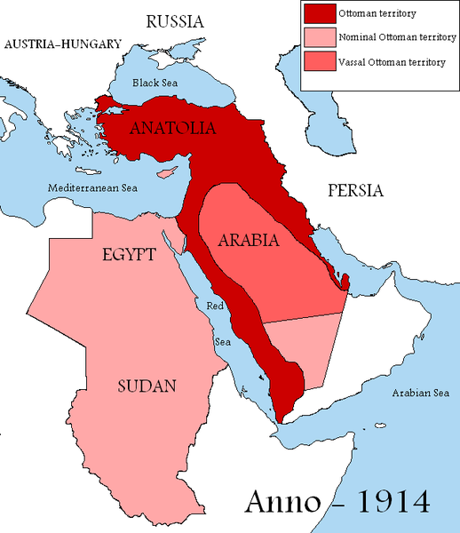
The Ottoman Empire 1914
By 1914 Ottoman Empire = “sick man of Europe”
decaying power
European powers made inroads:
Egypt was Britain's protectorate
Algeria was France’s colony
Italy had Libya

Slide 33
European Imperialism in 19th Century Iran
Early 19th century Iran included Afghanistan
European interests in Iran were similar:
France sought to compromise Britain’s links to India
Britain wanted links to India safeguarded
Russia needed warm water ports in Persian Gulf
The Nader Shah years were the glory years of Iran
When the Qajar Dynasty came to power in 1794, practically every shah from then until 1924 was inept, unimaginative, superstitious and selfish
willingly ignorant of Europe’s devices
ignored the noble traditions of Shi’i Iran

Slide 34
European Imperialism in 19th Century Iran
In early 19th century, Britain, France and Russia fell all over one another negotiating conflicting treaties with Iran
neither the shah or his advisors were shrewd enough to take advantage of this situation
Russia took a more aggressive tack: in 1812 expanded into the Caucus of Iran and fought the Persians at Aslanduz.
Russians victorious and entered into treaty with Iran

Slide 36
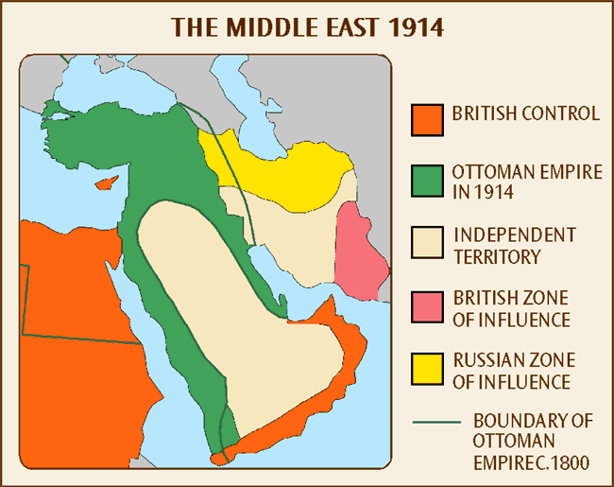
Spheres of Influence

Slide 37
World War I
When the Ottoman Empire entered WWI on the side of the Germans, France and Britain saw opportunity to make further strongholds
Using Indian troops the British invaded Mesopotamia (Iraq)
Arab Revolt led by Col. T Lawrence (famed “Lawrence of Arabia) in the Levant to secure Damascus and Jerusalem
Direct invasion of Turkey at the Battle of Gallipoli ended in a disaster for the British

Slide 38
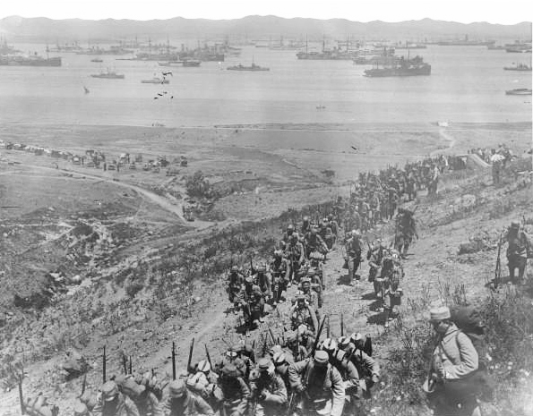
Gallipoli Campaign
April 25, 1915-Jan 9,1916
British and French naval and army forces attempted to take Constantinople and Dardanelles with large amphibious assault and failed, fraught with the difficulties of sweltering heat, widespread disease
Allied Forces failed to take the highlands and battles deteriorated into stalemated trench warfare
Casualties ran high on both sides:
Allies 220,000 killed/wounded (59%)
Ottoman/Germans 253,000 (60%) killed/wounded

Slide 39
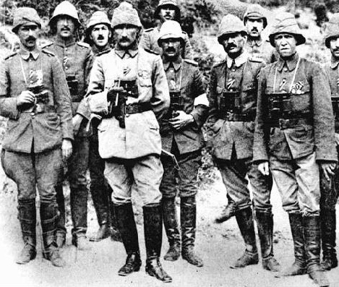
Gallipoli Campaign
Mustafa Kemal Ataturk became the front-line commander after correctly anticipating where the Allies would attack and holding his position until they retreated. he distinguished himself in battle and emerged as a national figure.
The battle is perceived as a defining moment in the history of the Turkish people: The struggle laid the grounds for the Turkish War of Independence and the foundation of the Republic of Turkey eight years later

Slide 40
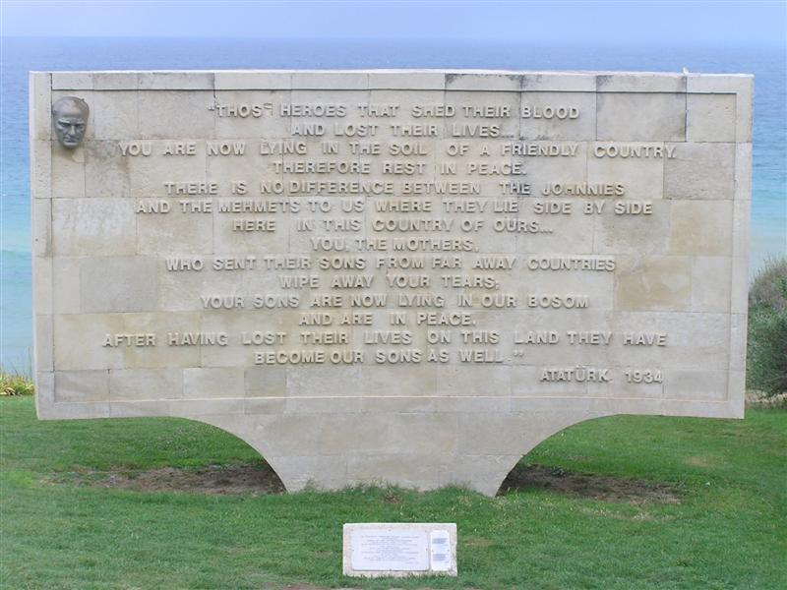

Slide 41
Arab Revolt
In World War I, in order to recruit Syrian Arabs to turn against their Ottoman masters, the British contracted with them with the promise to provide them lands from the spoils of war.
This uprising of Arabs stemming from Hijaz was led by Sharif Hussein in Mecca under direction of British high commissioner Sir Henry McMahon against the Ottoman empire starting in June 1916.
The desert war lasted two years assisted by British advisor Colonel T E Lawrence (Lawrence of Arabia).
The Hussein-McMahon Correspondence (promised Arab territories?) established relations between British and Jordan, Iraq and Arabia.
While British sought to protect India and Egypt (Suez),
Hussein sought to establish an Arab state.
The Correspondence is subject of great controversy: territorial promises to aspiring rebels.
In September 1918, as British forces invaded Damascus, Faisal (Hussein’s son) declared himself ruler of Syria. Unfortunately, Arab independence was never realized.

